Slide 1
Lecture 3
ANNOUNCEMENTS
HW2 is posted, due Tu 9/11
TAs will hold their office hours in 197 Cory
Prof. Liu’s office hours are changed to TuTh 12-1PM in 212/567 Cory
EE105 accounts can access EECS Windows Remote Desktop servers
OUTLINE
PN Junction Diodes (cont’d)
  Electrostatics (cont’d)
  I-V characteristics
  Reverse breakdown
  Small-signal model
Reading: Chapter 2.2-2.3, 3.4

Slide 2
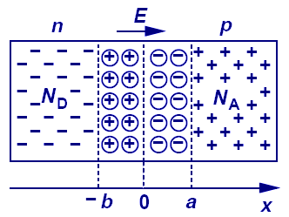
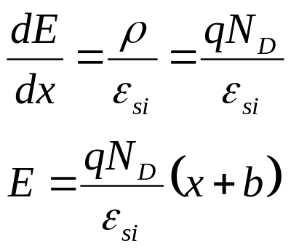
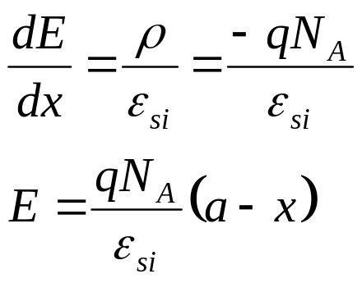
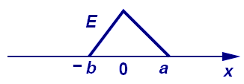

The Depletion Approximation
In the depletion region on the N side:
ρ(x)
In the depletion region on the P side:
qN_{D}
a
-b
x
-qN_{A}

Slide 3
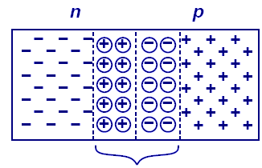
More on the Built-In Potential (V₀)
Q: Why can’t we harness V₀ and use the PN junction as a battery?
A: A built-in potential also exists at a junction between a metal and a semiconductor (e.g. at a contact).
If we connect the P and N regions together, there is no net voltage drop across the device:
?
+
V₀
–
  No net current flows across the junction when the externally applied voltage is 0 V!
V(x)
V₀
V_{bn}+V₀+V_{bp}=0
-b
a
x
V_{bn}
V₀
V_{bp}
0

Slide 4
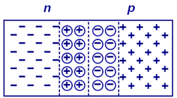
Effect of Applied Voltage
The quasi-neutral N-type and P-type regions have low resistivity, whereas the depletion region has high resistivity.
  Thus, when an external voltage V_{D} is applied across the diode, almost all of this voltage is dropped across the depletion region. (Think of a voltage divider circuit.)
If V_{D} < 0 (reverse bias), the potential barrier to carrier diffusion is increased by the applied voltage.
If V_{D} > 0 (forward bias), the potential barrier to carrier diffusion is reduced by the applied voltage.
V_{D}
–
+
I_{D}

Slide 5
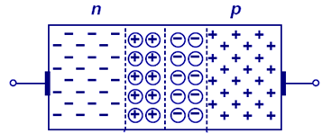
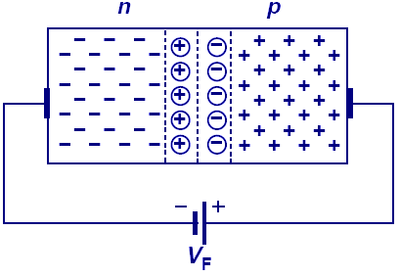
PN Junction under Forward Bias
A forward bias decreases the potential drop across the junction. As a result, the magnitude of the electric field decreases and the width of the depletion region narrows.
ρ(x)
qN_{D}
a
-b
x
-qN_{A}
I_{D}
V(x)
V₀
-b
a
x
0

Slide 6
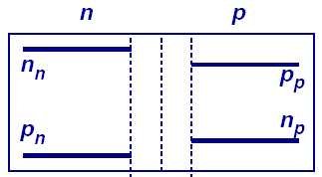
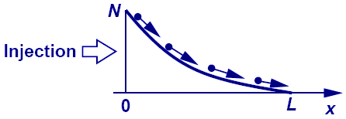
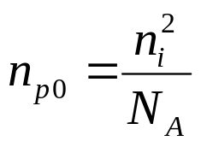
Minority Carrier Injection under Forward Bias
The potential barrier to carrier diffusion is decreased by a forward bias; thus, carriers diffuse across the junction.
  The carriers which diffuse across the junction become minority carriers in the quasi-neutral regions; they recombine with majority carriers, “dying out” with distance.
n_{p}(x)
n_{p0}
x'
x'
edge of depletion region
0
Equilbrium concentration of electrons on the P side:

Slide 7

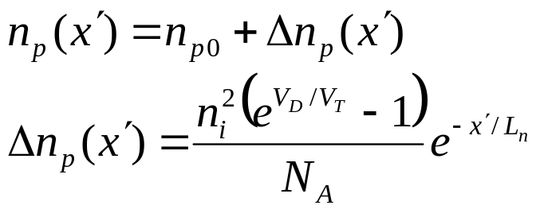
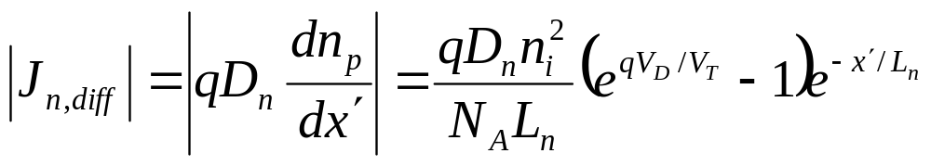
Minority Carrier Concentrations at the Edges of the Depletion Region
The minority-carrier concentrations at the edges of the depletion region are changed by the factor
  There is an excess concentration (Δp_{n}, Δn_{p}) of minority carriers in the quasi-neutral regions, under forward bias.
Within the quasi-neutral regions, the excess minority-carrier concentrations decay exponentially with distance from the depletion region, to zero:
Notation:
L_{n} ≡ electron diffusion length (cm)
x'

Slide 8
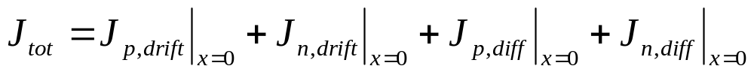
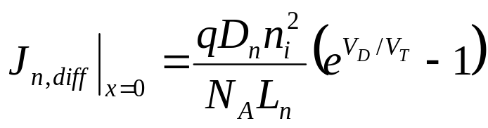
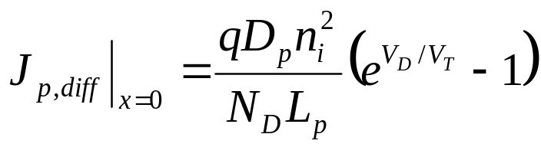
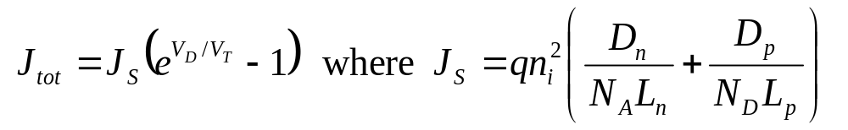
Diode Current under Forward Bias
The current flowing across the junction is comprised of hole diffusion and electron diffusion components:
Assuming that the diffusion current components are constant within the depletion region (i.e. no recombination occurs in the depletion region):

Slide 9
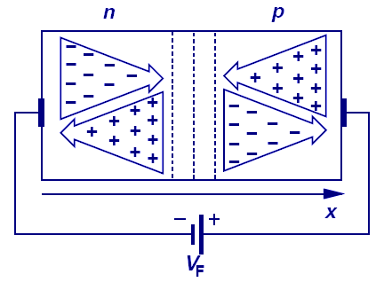
Current Components under Forward Bias
For a fixed bias voltage, J_{tot} is constant throughout the diode, but J_{n}(x) and J_{p}(x) vary with position.
J_{tot}
x
-b
0
a

Slide 10
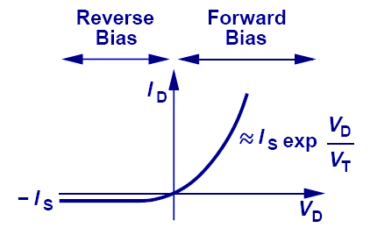
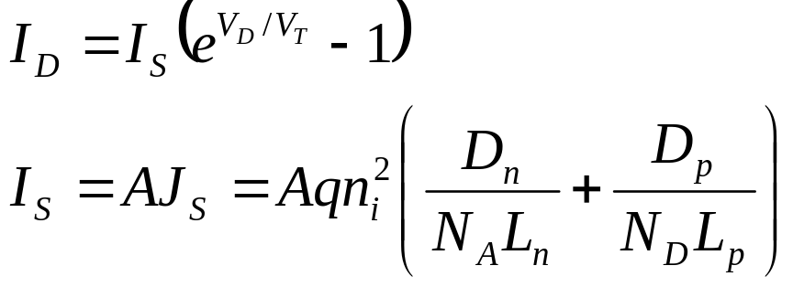
I-V Characteristic of a PN Junction
Current increases exponentially with applied forward bias voltage, and “saturates” at a relatively small negative current level for reverse bias voltages.
“Ideal diode” equation:

Slide 11
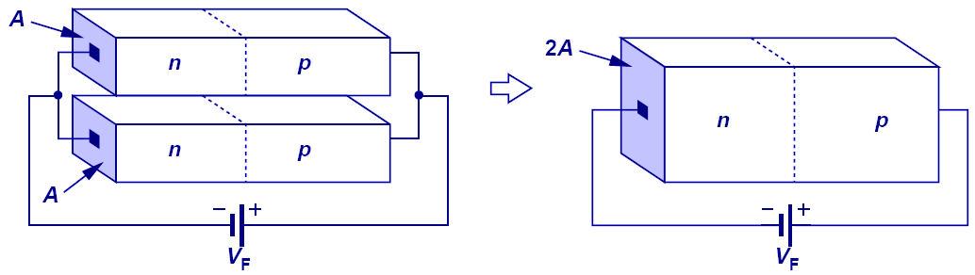
Parallel PN Junctions
Since the current flowing across a PN junction is proportional to its cross-sectional area, two identical PN junctions connected in parallel act effectively as a single PN junction with twice the cross-sectional area, hence twice the current.

Slide 12
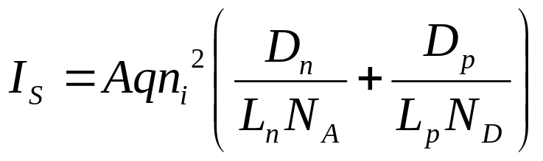
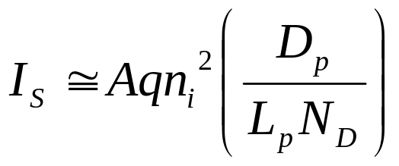
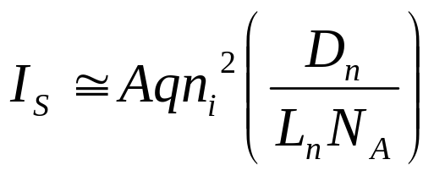
Diode Saturation Current I_{S}
I_{S} can vary by orders of magnitude, depending on the diode area, semiconductor material, and net dopant concentrations.
  typical range of values for Si PN diodes: 10⁻¹⁴ to 10⁻¹⁷ A/μm²
In an asymmetrically doped PN junction, the term associated with the more heavily doped side is negligible:
  If the P side is much more heavily doped,
  If the N side is much more heavily doped,

Slide 13
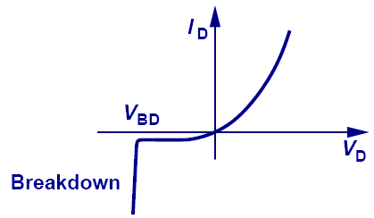
Reverse Breakdown
As the reverse bias voltage increases, the electric field in the depletion region increases. Eventually, it can become large enough to cause the junction to break down so that a large reverse current flows:
breakdown voltage

Slide 14
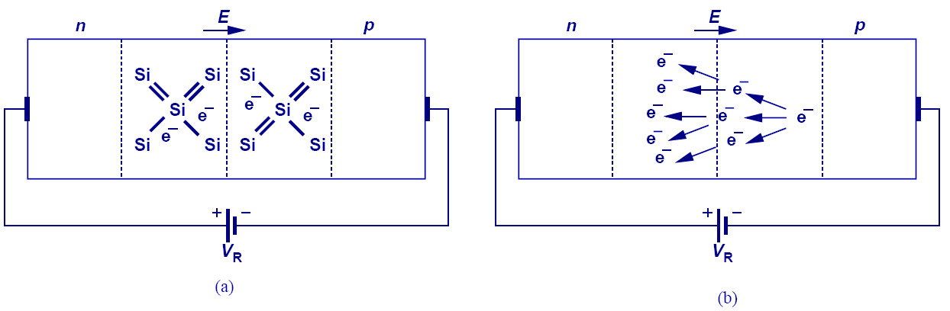
Reverse Breakdown Mechanisms
Zener breakdown occurs when the electric field is sufficiently high to pull an electron out of a covalent bond (to generate an electron-hole pair).
Avalanche breakdown occurs when electrons and holes gain sufficient kinetic energy (due to acceleration by the E-field) in-between scattering events to cause electron-hole pair generation upon colliding with the lattice.

Slide 15
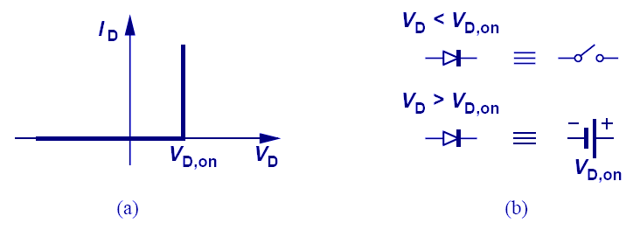
Constant-Voltage Diode Model
If V_{D} < V_{D,on}: The diode operates as an open circuit.
If V_{D} ≥ V_{D,on}: The diode operates as a constant voltage
source with value V_{D,on}.

Slide 16
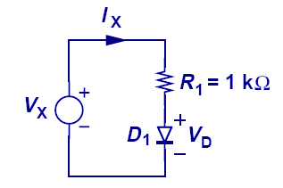
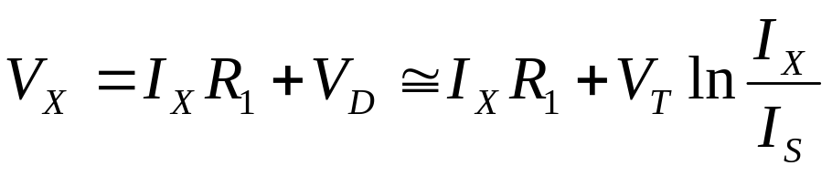
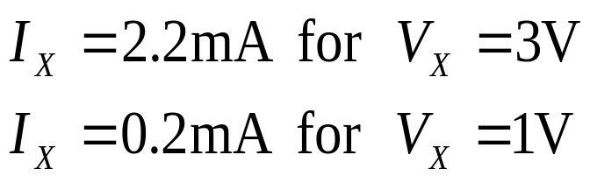
Example: Diode DC Bias Calculations
This example shows the simplicity provided by a constant-voltage model over an exponential model.
Using an exponential model, iteration is needed to solve for current. Using a constant-voltage model, only linear equations need to be solved.

Slide 17
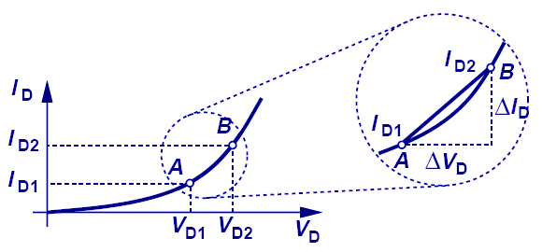
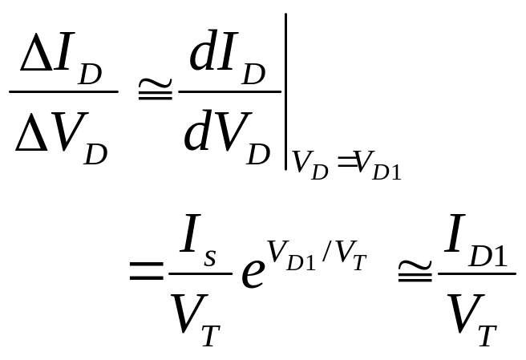
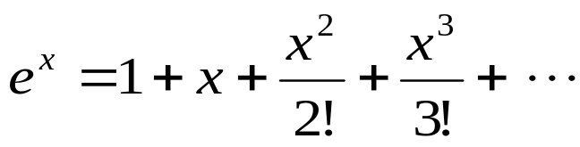
Small-Signal Analysis
Small-signal analysis is performed at a DC bias point by perturbing the voltage by a small amount and observing the resulting linear current perturbation.
  If two points on the I-V curve are very close, the curve in-between these points is well approximated by a straight line:

Slide 18
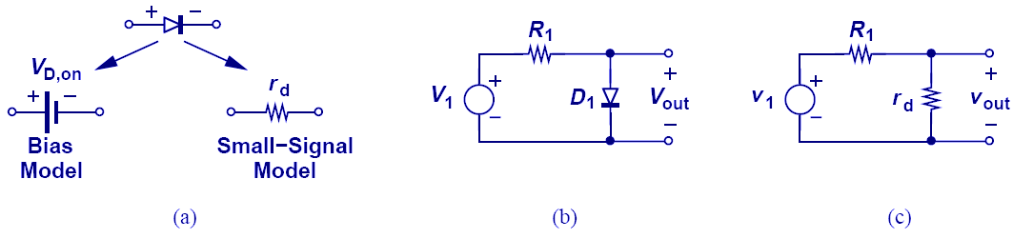
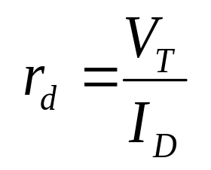
Diode Small-Signal Model
Since there is a linear relationship between the small-signal current and small-signal voltage of a diode, the diode can be viewed as a linear resistor when only small changes in voltage are of interest.
Small-Signal Resistance
(or Dynamic Resistance)

Slide 19
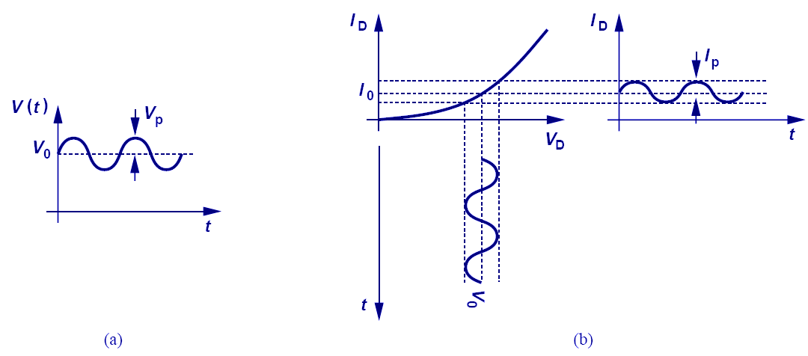

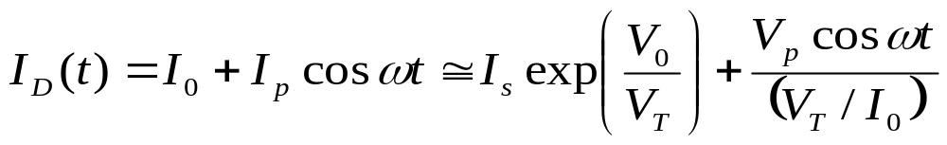
Small Sinusoidal Analysis
If a sinusoidal voltage with small amplitude is applied in addition to a DC bias voltage, the current is also a sinusoid that varies about the DC bias current value.

Slide 20
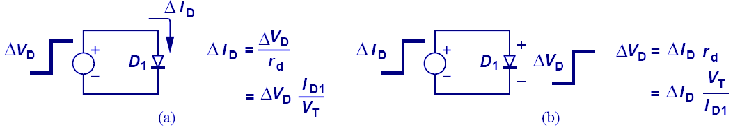
Cause and Effect
In (a), voltage is the cause and current is the effect. In (b), current is the cause and voltage is the effect.

Slide 21

Summary: PN-Junction Diode I-V
Under forward bias, the potential barrier is reduced, so that carriers flow (by diffusion) across the junction
  Current increases exponentially with increasing forward bias
  The carriers become minority carriers once they cross the junction; as they diffuse in the quasi-neutral regions, they recombine with majority carriers (supplied by the metal contacts)
    “injection” of minority carriers
Under reverse bias, the potential barrier is increased, so that negligible carriers flow across the junction
  If a minority carrier enters the depletion region (by thermal generation or diffusion from the quasi-neutral regions), it will be swept across the junction by the built-in electric field
    “collection” of minority carriers

